Slide 1
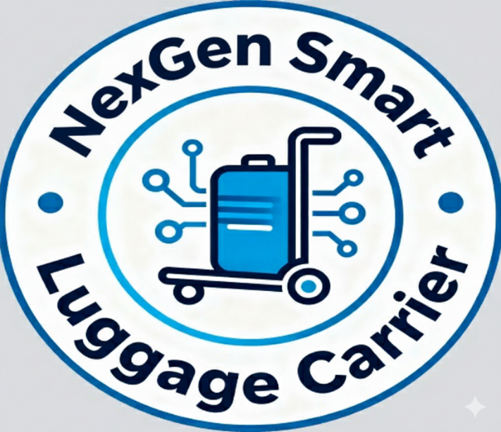




TECH ANDHRA
P. Sateesh
sateeshpamisetty@gmail.com
8179793529
K. Ashwini
ashwinihoney384@gmail.com
J. V. Deepak
jonnaduladeepak3@gmail.com

Slide 2
Outline
Idea
Problem Statement
Existing Solution
Proposed Solution
Web Interface
Comparison of Problem statement and Existing solution
Simulation
Sustainable development goals

Slide 3
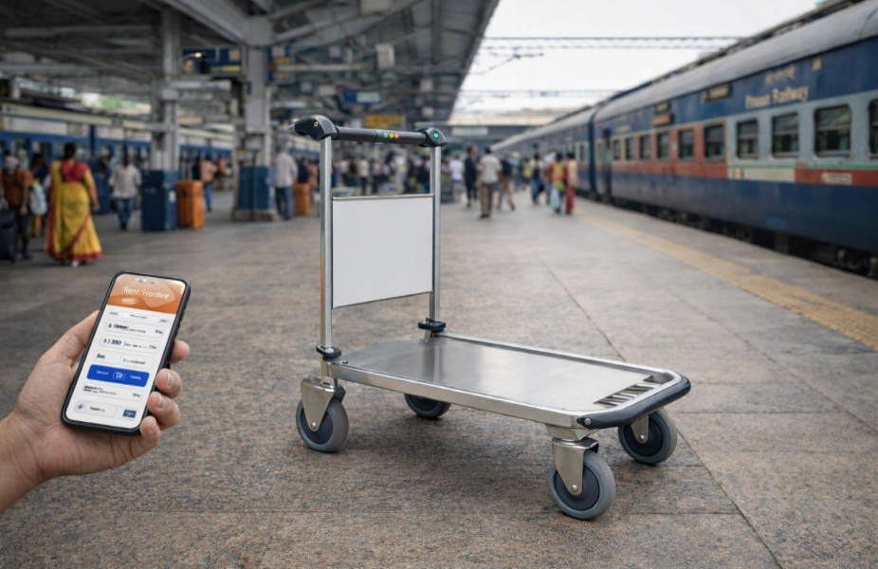
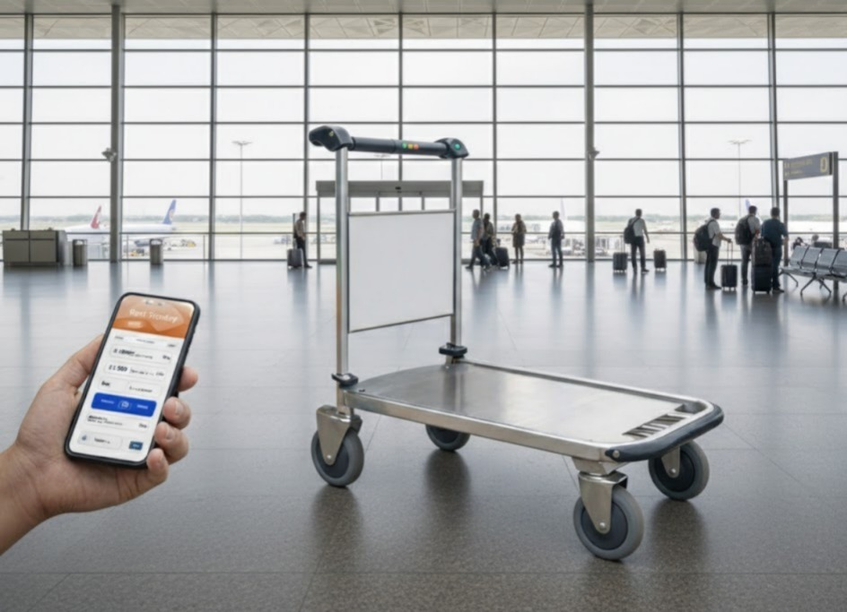
idea
Motor-assisted, GPS-tracked trolleys rented via app/kiosk with digital, time-based payment.
Trolleys feature integrated restraints and are under the user's direct, tracked control.
Cheaper than porters, offering independence for all passengers
Easily scalable to airports and major transit hubs, simplifying luggage movement across long terminals.

Slide 4
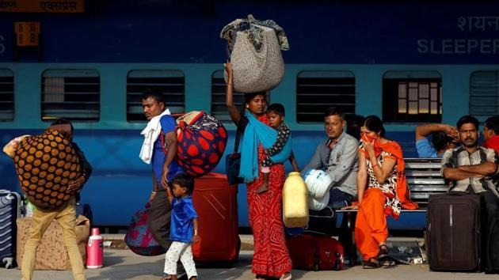
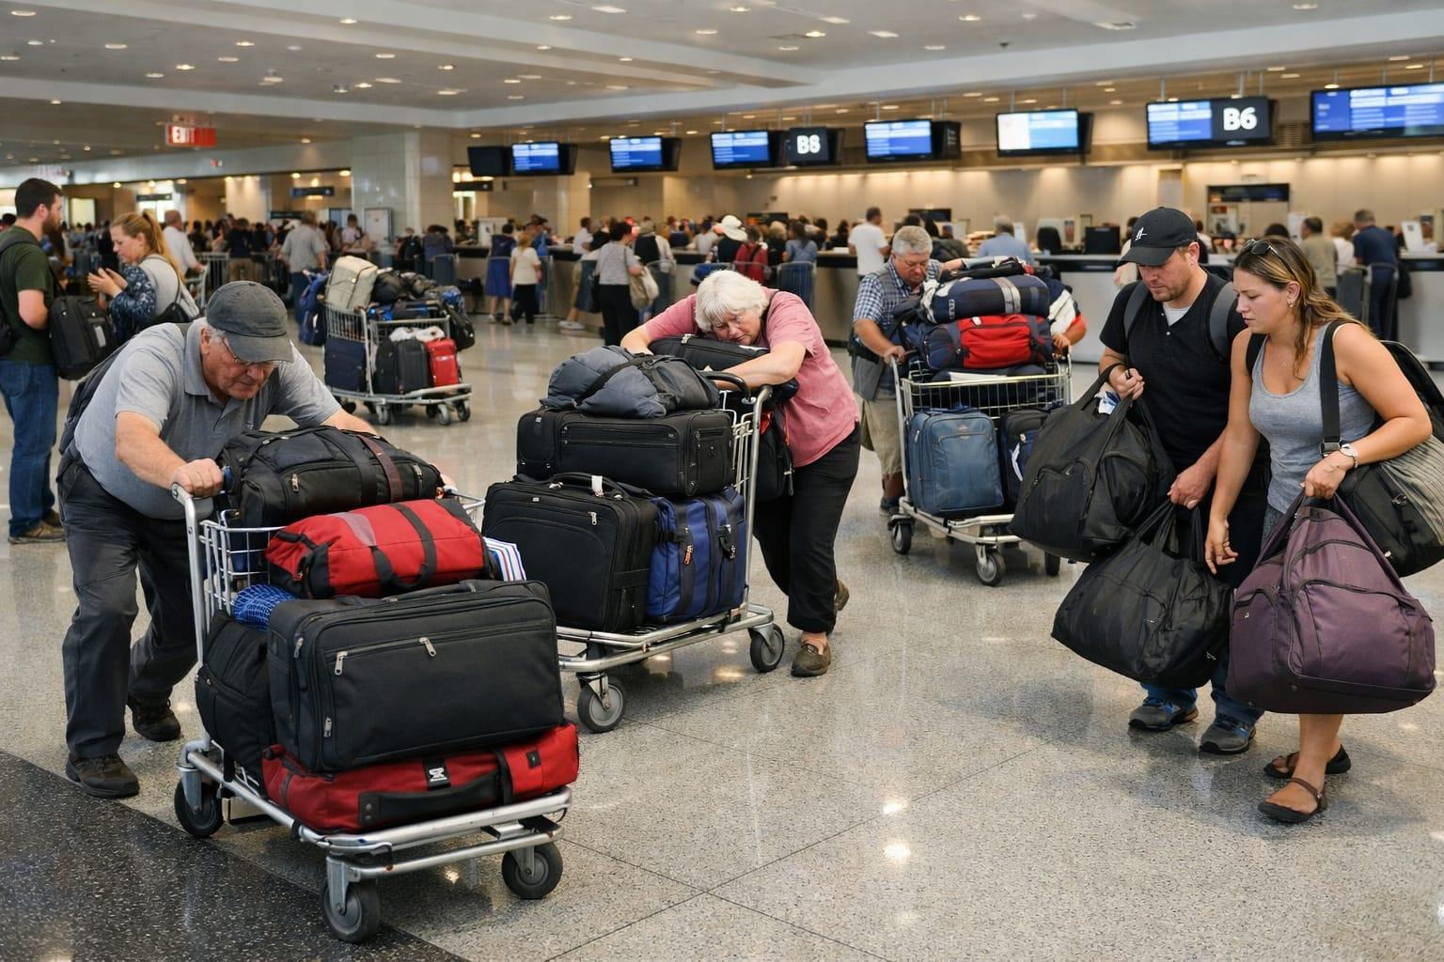
Problem Statement
Passengers struggle with heavy bags on long platforms.
Current options (porters, e-vehicles) are costly and unreliable.
An affordable, reliable self-service transport system is needed.
Motor-assisted rental trolleys offer convenience and independence.

Slide 5
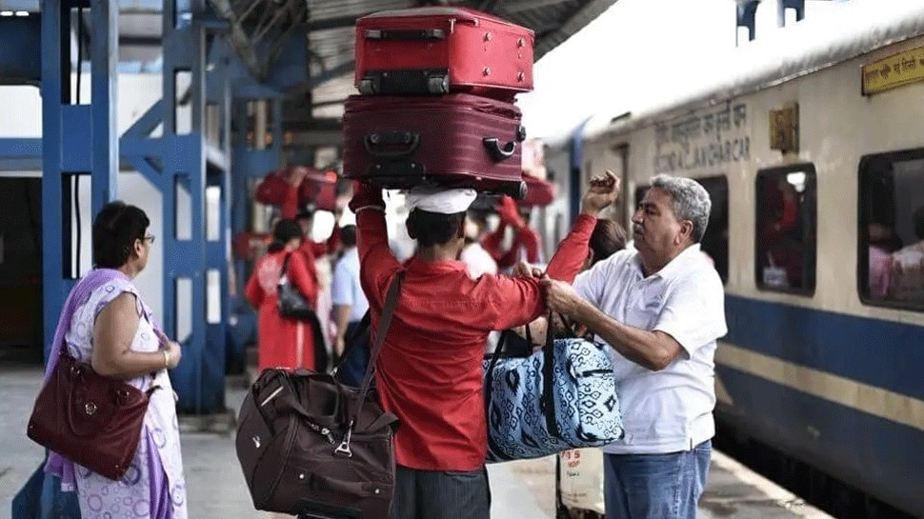
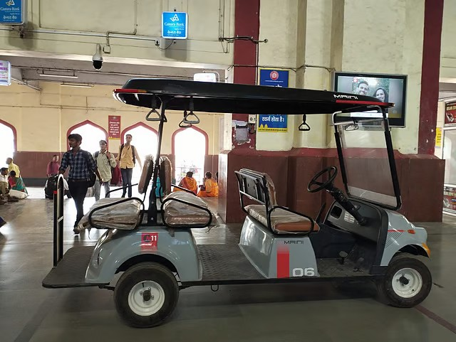
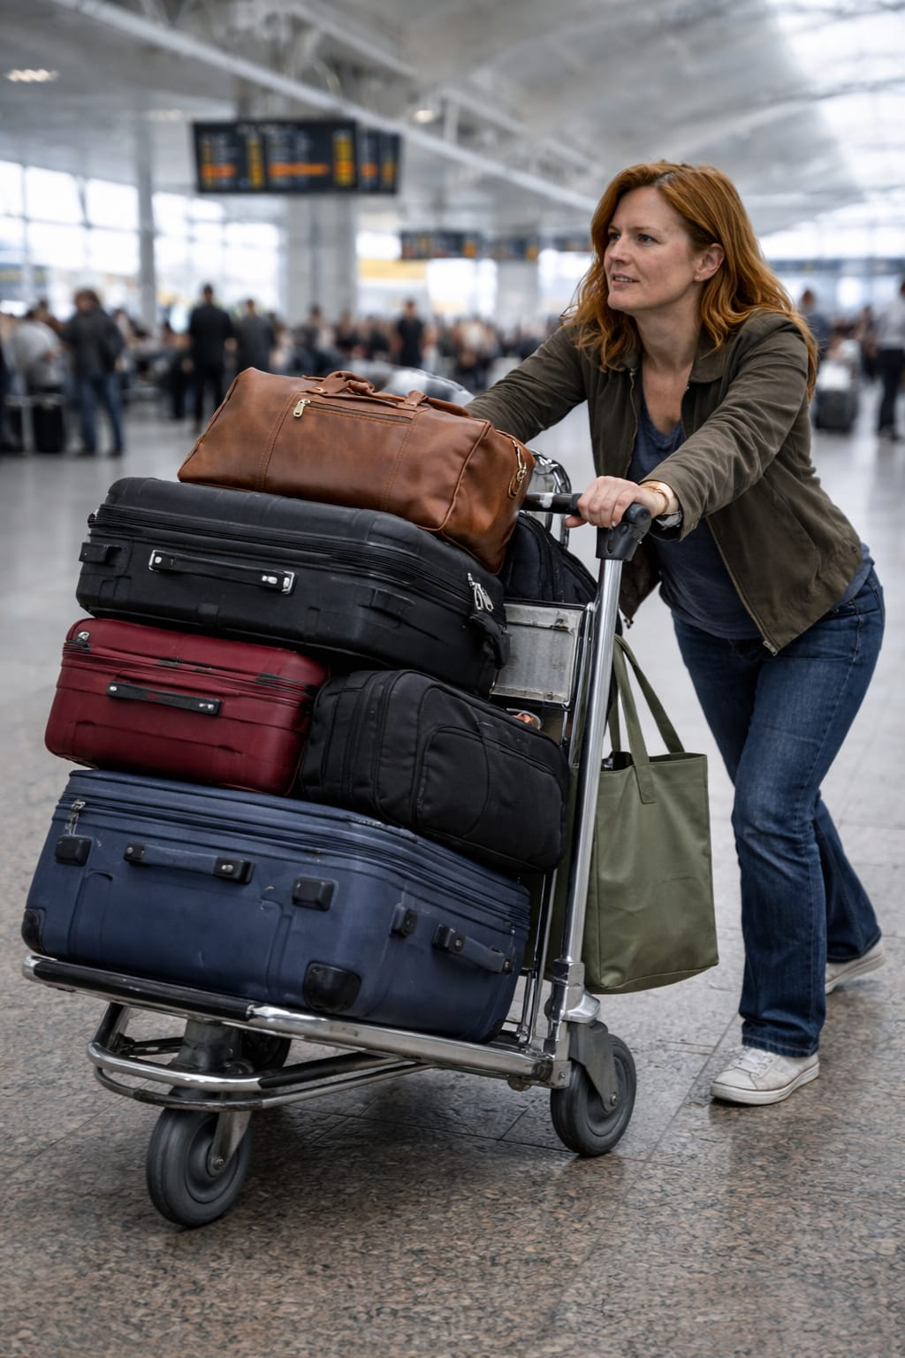
Existing solution

Slide 6
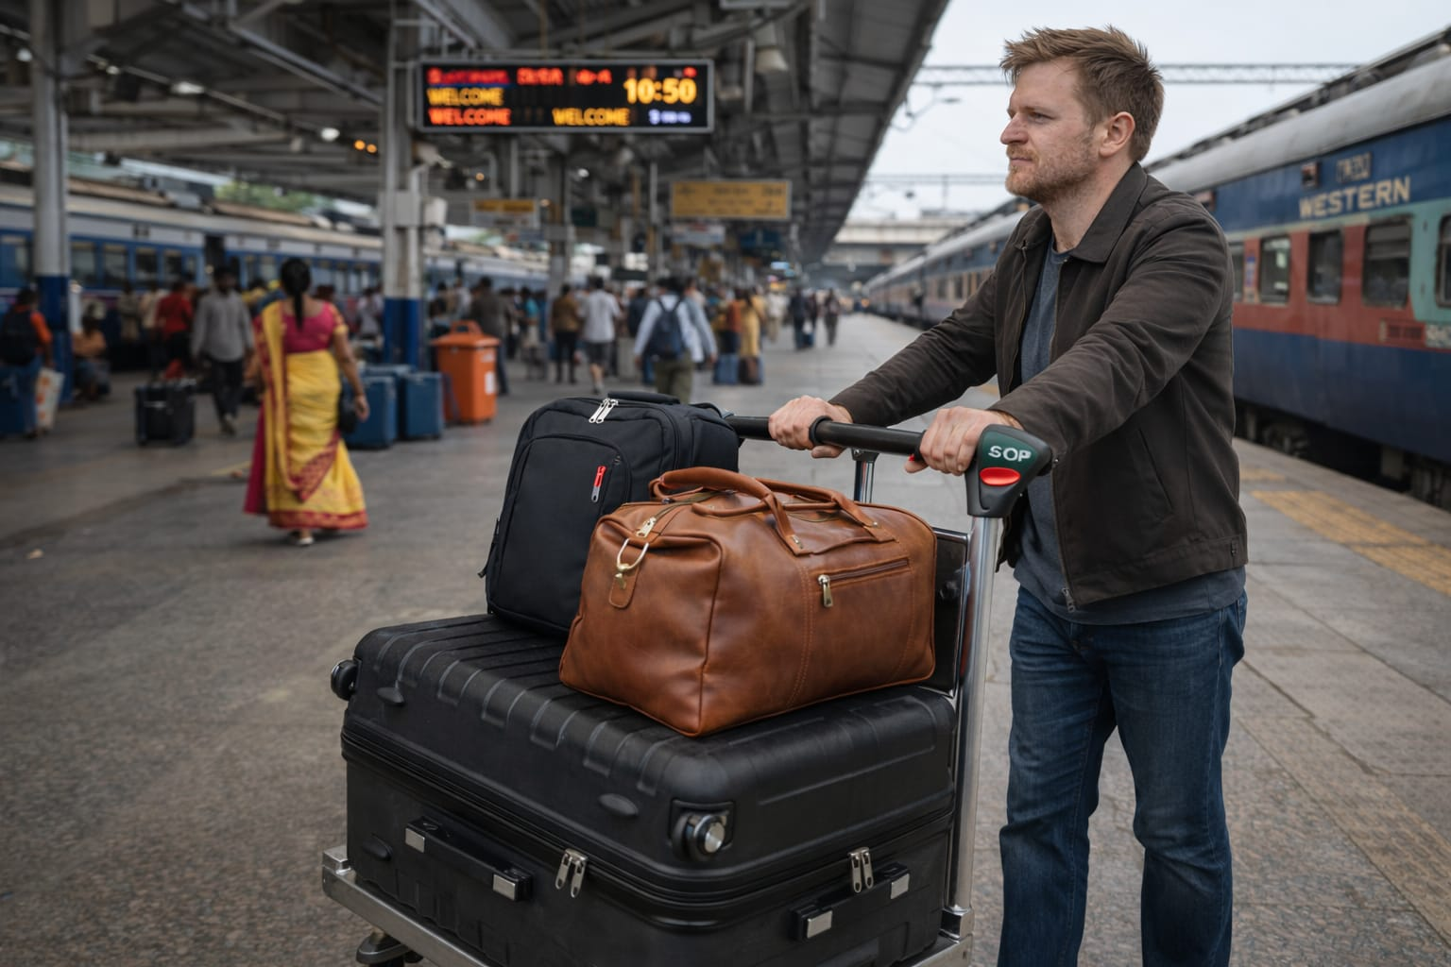
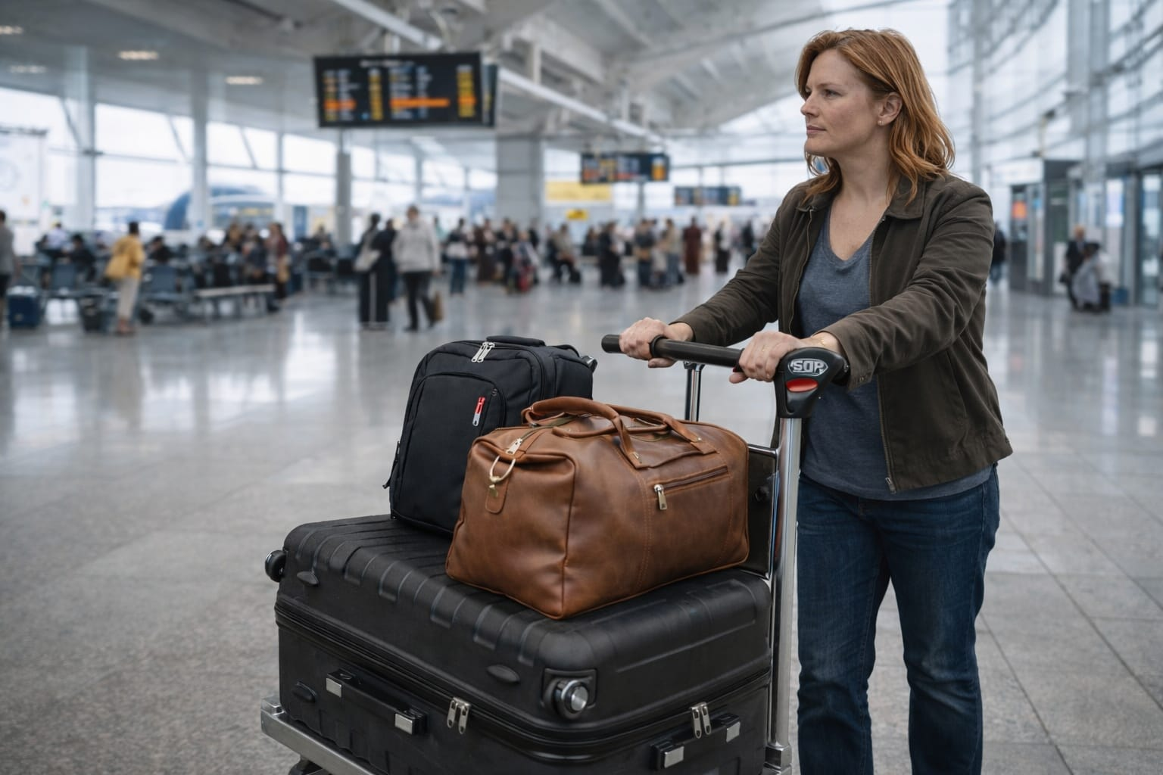
Proposed Solution
Proposed in Railways and Airports for Luggage Trolley system.
It is motor-assisted and lightweight for easy transport.
Passengers can move multiple bags without physical effort or needing porters.
The service uses an affordable pay-per-use rental model.

Slide 7
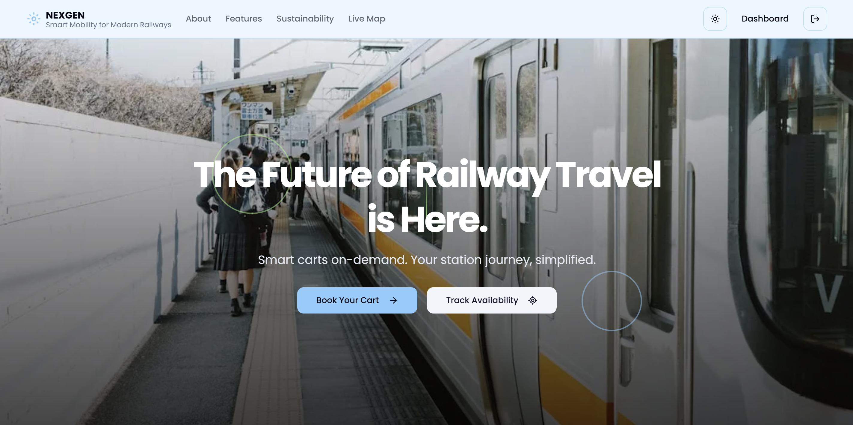
App interface
https://9000-firebase-studio-1761551332216.cluster-nle52mxuvfhlkrzyrq6g2cwb52.cloudworkstations.dev/

Slide 8
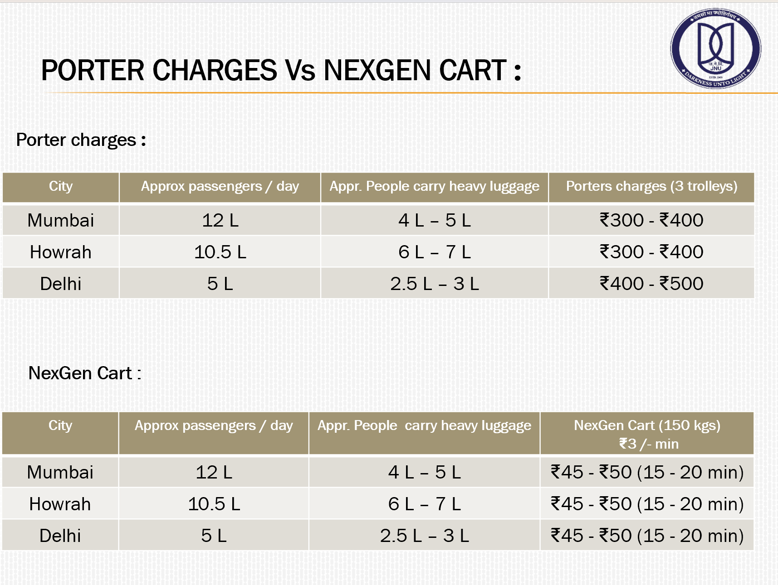

Slide 9
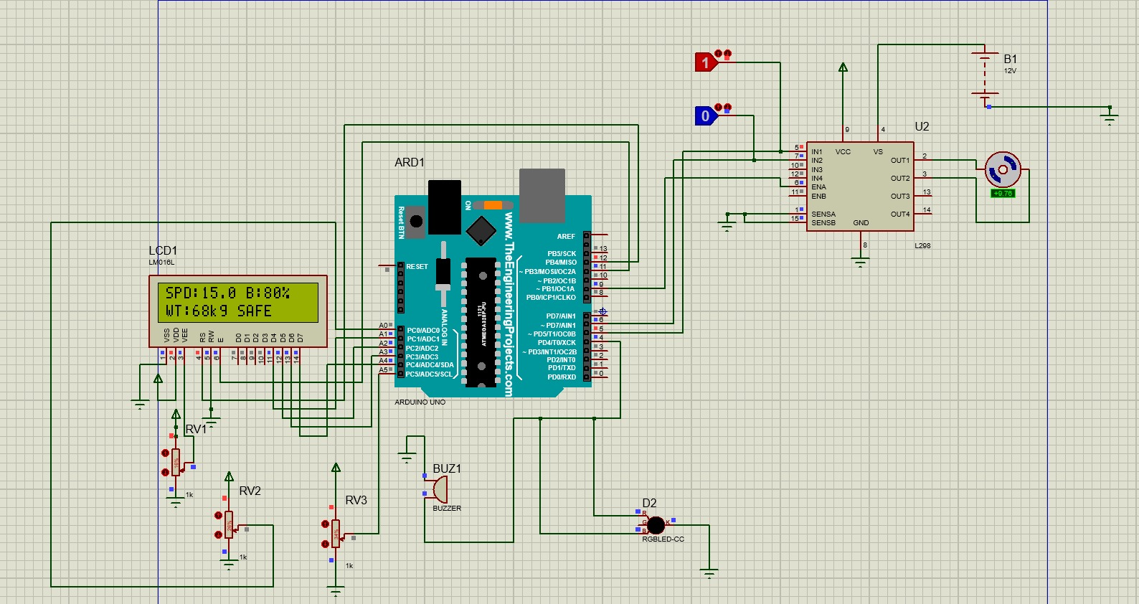
Simulation

Slide 10
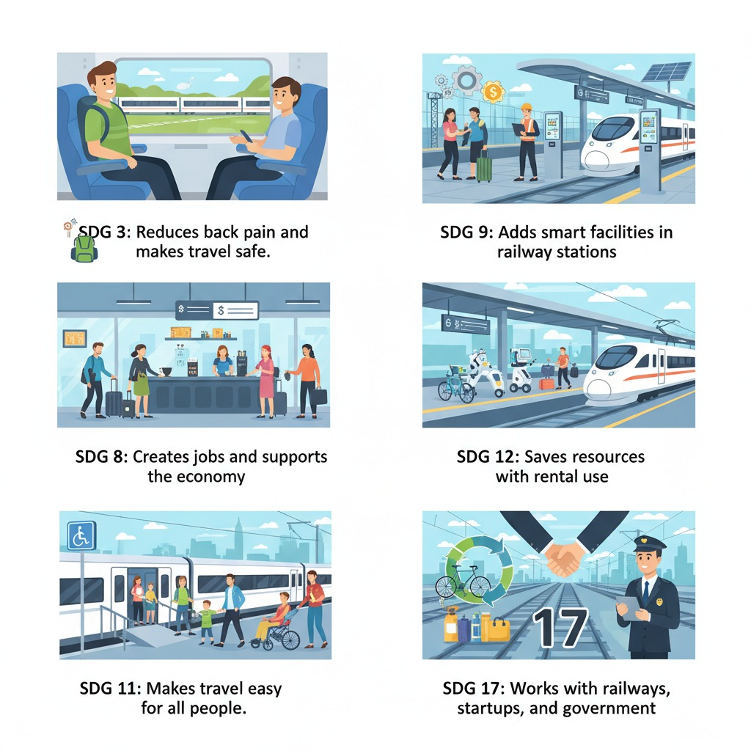
Sustainable development goals

